Slide 1
Econometric Research: GDP, Educational Expenditures, and Military Expenditures
Liam Lindy

Slide 2
Question
Main Question: Does increasing educational expenditures and decreasing military expenditures?
This all was a percent of GDP
More variables are needed to fully explore this question

Slide 3
Theory
GDP growth rate related to eduational expenses and military expenditures
Tax revenues, central government debt, and changes in population affect this
Real GDP is important
Analyzing over time is critical

Slide 4
Data Source
Source: World Development Indicators
Scale: All variables are stored as percentages where it makes sense
Not decimals
ex: 10% not 0.1
Important, because makes a large difference when it comes to

Slide 5
Variables
Dependent Variables
GDP growth rate
Independent Variables Variables
Log of real GDP
Military Expenditures as a percentage of GDP
Educational Expenditures as a percentage of GDP
Population Growth
Year
Total Central Government Debt as a percentage of GDP
Tax Revenues as a percentage of GDP

Slide 6
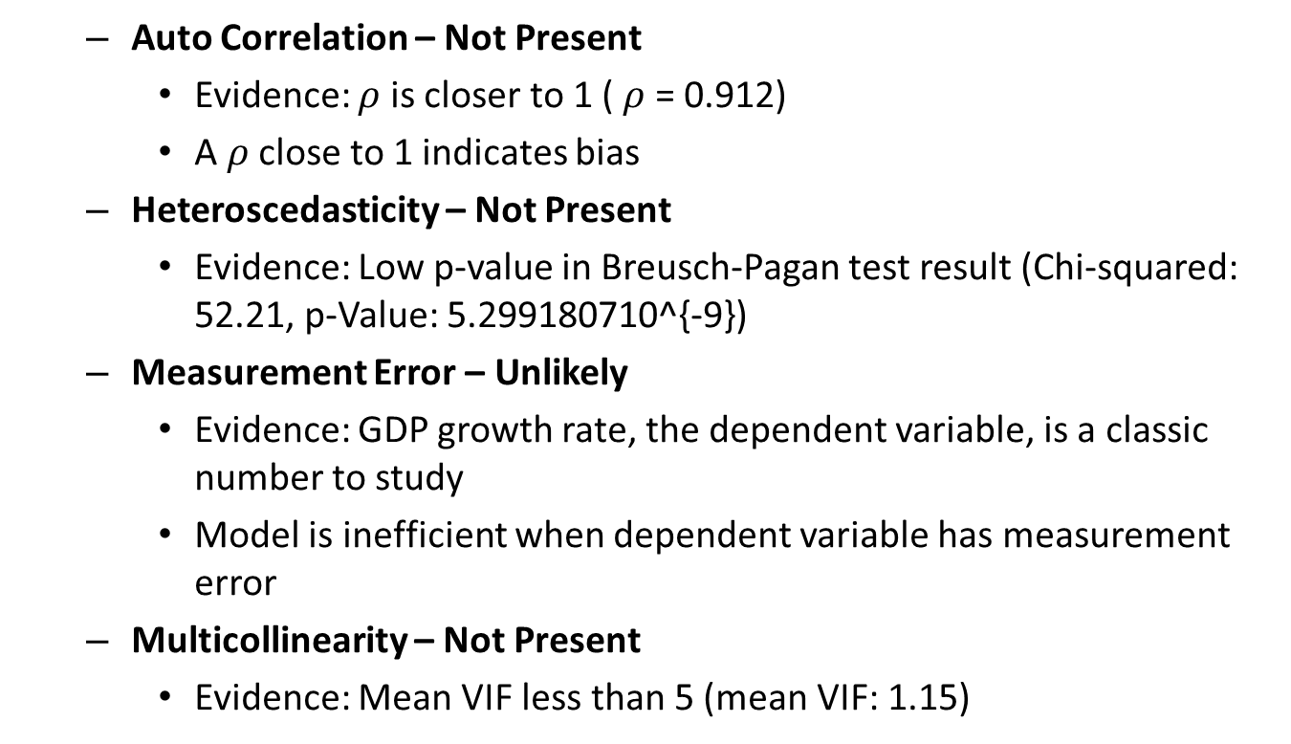
Econometric Issues & Solutions - Inefficiencies
Auto Correlation – Not Present
Evidence: $ρ$ is closer to 1 ( $ρ$ = 0.912)
A $ρ$ close to 1 indicates bias
Heteroscedasticity – Not Present
Evidence: Low p-value in Breusch-Pagan test result (Chi-squared: 52.21, p-Value: 5.299180710^{-9})
Measurement Error – Unlikely
Evidence: GDP growth rate, the dependent variable, is a classic number to study
Model is inefficient when dependent variable has measurement error
Multicollinearity – Not Present
Evidence: Mean VIF less than 5 (mean VIF: 1.15)

Slide 7
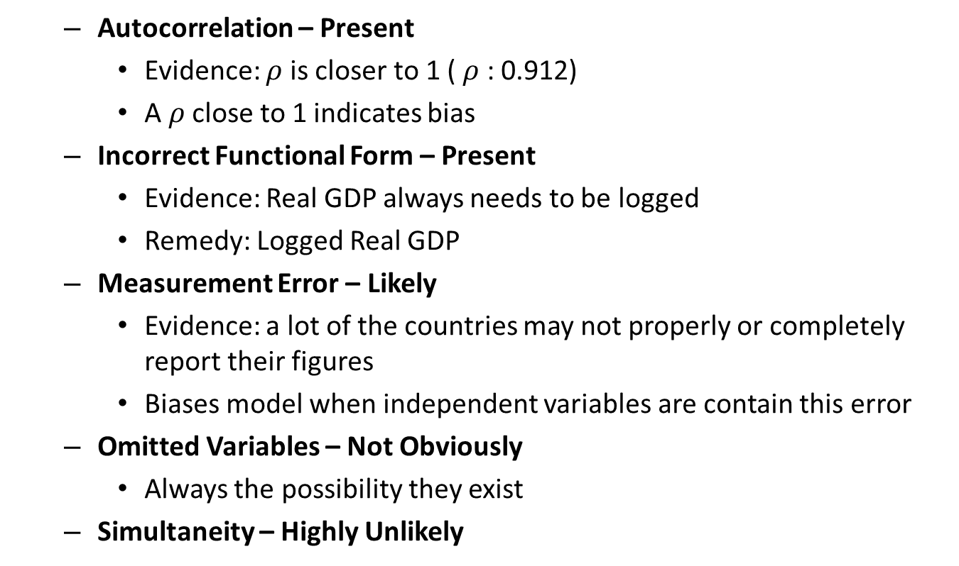
Econometric Issues & Solutions - Biases
Autocorrelation – Present
Evidence: $ρ$ is closer to 1 ( $ρ$ : 0.912)
A $ρ$ close to 1 indicates bias
Incorrect Functional Form – Present
Evidence: Real GDP always needs to be logged
Remedy: Logged Real GDP
Measurement Error – Likely
Evidence: a lot of the countries may not properly or completely report their figures
Biases model when independent variables are contain this error
Omitted Variables – Not Obviously
Always the possibility they exist
Simultaneity – Highly Unlikely

Slide 8
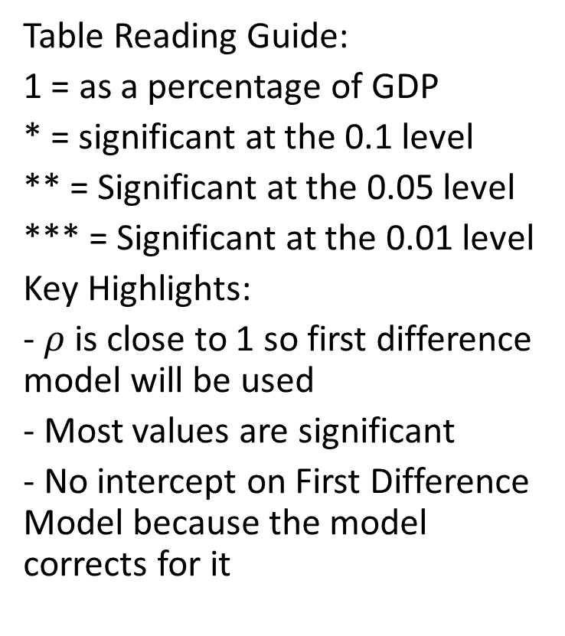
Final Results
Table Reading Guide:
1 = as a percentage of GDP
* = significant at the 0.1 level
** = Significant at the 0.05 level
*** = Significant at the 0.01 level
Key Highlights:
- $ρ$ is close to 1 so first difference model will be used
- Most values are significant
- No intercept on First Difference Model because the model corrects for it

Slide 9
Models
Baseline Ordinary Least Squares:
$$GDP_{growth rate} = -11.18 -0.17 lnGDP_{2010 USD} \\ -0.02 MilitaryExpenditures_{GDP} -0.63 Education Expenditures_{GDP} \\ + 0.4 PopulationGrowth_{annualpercent}+ 0.01 Time \\ -0.02 TotalDebt+ 0.05 TaxRevenue$$
First Differences Model:
$$GDP_{growth rate} = 68.337 lnGDP_{2010 USD} \\ - 0.18 MilitaryExpenditures_{GDP} - 0.973 Education Expenditures_{GDP} \\ - 0.964 PopulationGrowth_{annualpercent} - 2.323 Time \\ + 0.008 TotalDebt - 0.122 TaxRevenue$$

Slide 10
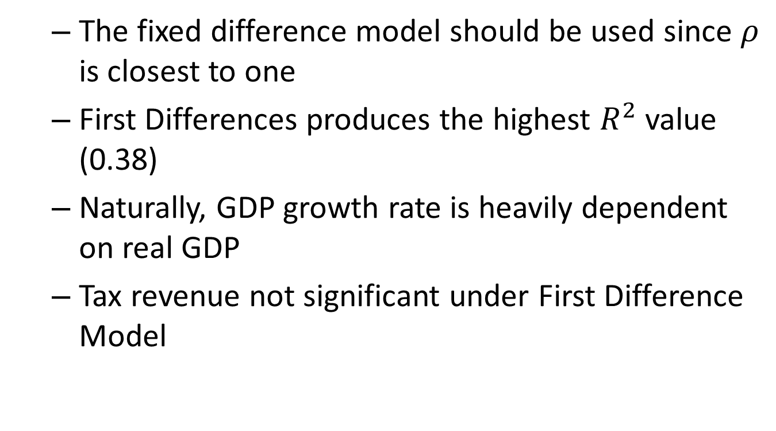
Main Conclusions
The fixed difference model should be used since $ρ$ is closest to one
First Differences produces the highest $R^{2}$ value (0.38)
Naturally, GDP growth rate is heavily dependent on real GDP
Tax revenue not significant under First Difference Model

Slide 11
Questions?

